Slide 1
Visual Studio Tooling for SharePoint 2013
Name
Title
Company

Slide 2
Agenda
SharePoint 2013 Development
SharePoint Application Design Patterns
Creating a SharePoint App Project
Packaging and Deployment

Slide 3
SharePoint 2013 Investment
SharePoint 2013 Investment is with SharePoint Apps
Significant new functionality added to Visual Studio 2012
All of CSOM made available through REST
New Security Model created based on OAuth
SharePoint Solution Development is Still Possible
Accomplished by creating "Classic" SharePoint projects
Not an area of investment for improvement in SharePoint 2013
Works for the most part just as it has in SharePoint 2010
Notes:
Microsoft’s primary investment with SharePoint 2013 is in the new SharePoint app development model. There is significant new functionality in Visual Studio 2012 for creating and debugging apps. Furthermore, the underlying development platform has been extended so its CSOM functionality has also been made available through REST as well. For Office 365, there is a new security model created based on an emerging authentication protocol known as OAuth.
SharePoint Solution Development is Still Possible. This is accomplished by creating "Classic" SharePoint projects. However, you should understand that this is not a significant area of investment for improvement in SharePoint 2013. The development of farm solutions and sandboxed solutions works for the most part just as it has in SharePoint 2010.

Slide 4
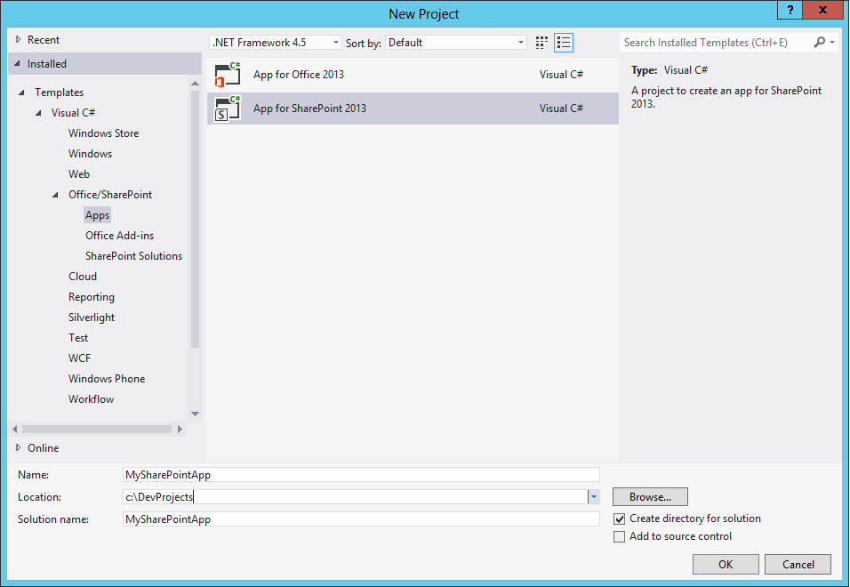
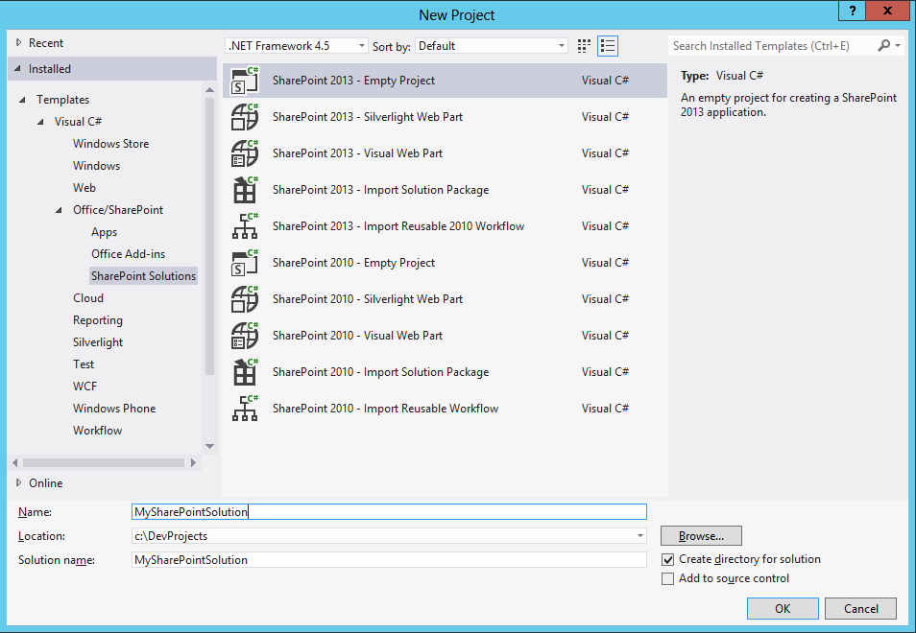
App Versus Solutions Development
Visual Studio project templates for 2 different styles
App Development
Classic Solutions Development
App Development
Classic Solutions Development
Notes:
For the development of SharePoint apps, there is a single Visual Studio project template. All the other project templates created for SharePoint 2013 development are for solution development.
Download Visual Studio Tools
http://msdn.microsoft.com/en-us/office/apps/fp123627

Slide 5
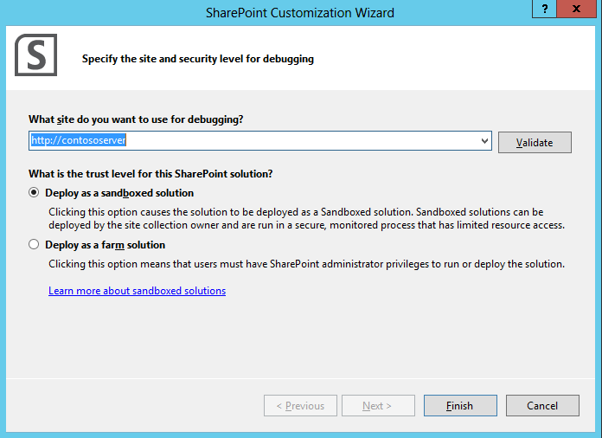
"Classic" SharePoint Projects
Created using SharePoint 2013 Project Template
Developer must select Farm Solution or Sandboxed Solution
Notes:
When creating a SharePoint solution, you will create a new project from one of the many project templates dedicated to solutions development. When you create a new project for a SharePoint solution, Visual Studio will prompt you to select Deploy as a sandboxed solution or Deploy as a farm solution. Remember that you choice can be changed after the project has been created by changing a project property.

Slide 6
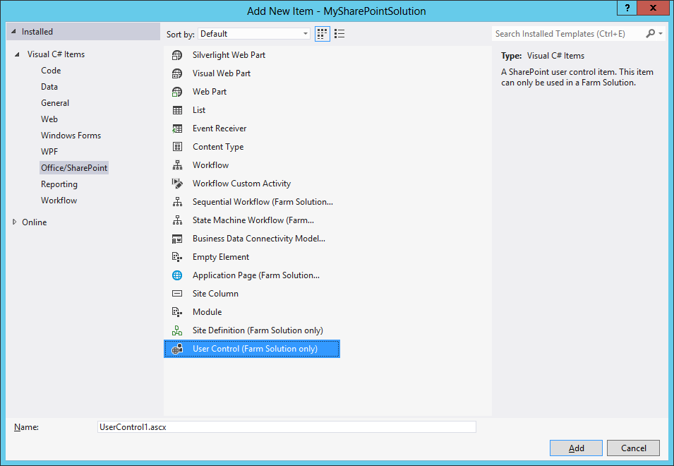
Adding Items to a Classic Solution
You can add many types of items to "Classic" project
Many familiar item types not supported in SharePoint App
Some item types not supported in sandboxed solutions
Notes:
You can add many different types of project items to solution project. Many of these project item will be familiar to developers who have developed solutions for SharePoint 2010. Also note that many of these project item templates will not be available when developing apps. This includes any project item templates that requires adding files into the SharePoint root directory as well as any ones that are based on server-side code. Note that the project item templates that are not available in sandboxed solutions as marked as Farm Solution Only.

Slide 7
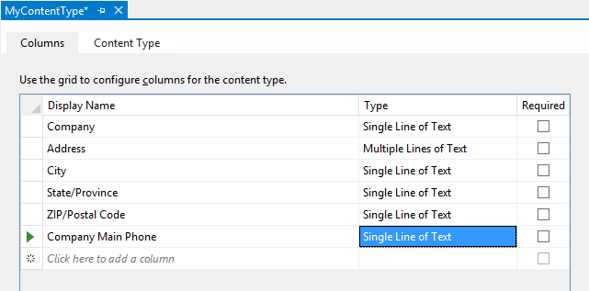
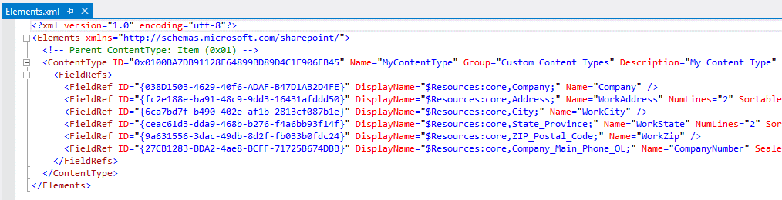
Site Columns and Content Types
Project Items to create Custom List Schema
Site column used to create reusable column definition
Content type defines columns for list or document library
Visual Studio provides new Content Type Editor
Elements.xml automatically edited behind scenes
Notes:
Visual Studio 2012 adds some new features for SharePoint development that were not available in the previous version. This includes project item templates to create site columns and to create custom list definitions using a new visual designer. The list designer makes it possible to create new lists either with or without the use of explicit content types. The best part about the visual designer is that it is able to edit the files for a list definition such as the elements.xml file and the schema.xml file behind the scenes.

Slide 8
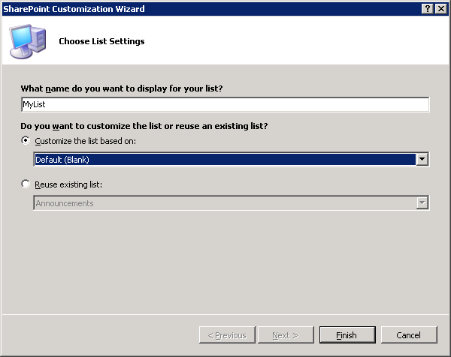
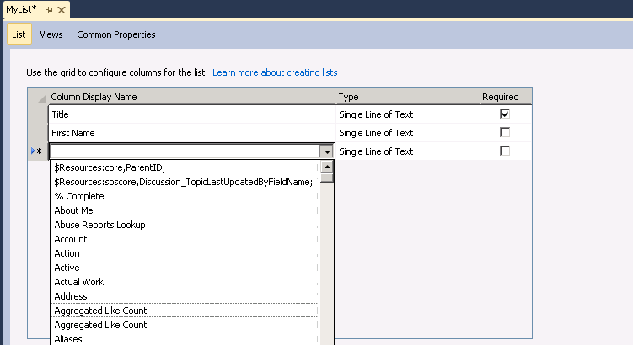
Adding Lists
Adding List provides new customization option
List can be created with customized set of columns
VS Editor actually created List Definition Behind the Scenes
Notice thought that list definitions are NOT supported with hosted deployments like Office365
Notes:
Note that unlike the previous version, Visual Studio 2012 does not provide separate item templates for List Instance and List Definition. Instead, there is just a single List project item template. When you create a new project item based on the list project item template, Visual Studio prompts you to select between these two choices:
Customize the list based on: [choice of list type]
Reuse existing list: [choice of list type]
By selecting Customize the list you are effectively creating a new list definition where you can add a custom columns. Visual Studio also creates a list instance from this list definition.
By selecting Reuse existing list you are simply creating a list instance based on one of the built-in list types such as Announcement, Contacts or Tasks.

Slide 9
Solution Deployment
Solutions are deployed using Solution Packages
Solution package is CAB file with .wsp extension
Solution package contains manifest.xml file
Solution package optionally contains declarative elements
Solution package optionally contains DLL with server-side code
Solution packages can be deployed two ways
Farms solutions deployed at farm scope
Sandboxed solutions deployed as site collection scope
MySPSolution.wsp
manifest.xml
feature.xml
elements.xml
SitePage1.aspx
MySPSolution.dll
Notes:
Just as in SharePoint 2010, SharePoint Solutions are deployed using a special type of CAB file with a file extension of .wsp known as a Solution Package. A solution package is a container that always holds a manifest file with the well-known name of manifest.xml.
A solution package can optionally contain declarative elements to create site elements such as pages, lists and navigation items. In case where a SharePoint solution contains server-side code written in C# or VB.NET, a solution package contains an assembly DLL.
A solution packages can be deployed one of two different ways:
Farms solutions deployed at farm scope and provide the most power to developers
Sandboxed solutions deployed as site collection scope and can be deployed up to sites within Office 365

Slide 10
Using the New List Designer
demo

Slide 11
SharePoint Application Design Patterns

Slide 12
The Host Web and The App Web
Installation of App creates child site in target site
Host Web is the site into which the App is installed
App Web created by SharePoint during App installation
App Web provides scope for private implementation details
App can add declarative items to App Web declarative items are lists, pages, CSS files, JavaScript files, etc.
SharePoint Environment
Site Collection
Host Web
App Web
Notes:
When you install a SharePoint application within a specific site, SharePoint creates a child site for the application. The target site where the app has been installed is known as the host web and the child site for the app is known as the app web.
The app web provides an app with a scope for private implementation details. You can add declarative items to app web such as lists, pages, CSS files, images and JavaScript files. Note that the app has full permissions to add items to the app web but it has no permissions (by default) to add items to the host web.

Slide 13
Restrictions on Server-side Code
Farm Solutions
Server-side code runs inside SharePoint environment at full trust
Code has full access to SharePoint server-side object model
Sandboxed Solutions
Server-side code runs inside SharePoint environment at partial trust
Code has limited access to SharePoint server-side object model
SharePoint Apps
Apps cannot run server-side code in SharePoint environment
SharePoint App cannot access SharePoint server-side object model
SharePoint App can run server-side code in external environment
Notes:
Farm solutions give the developer the greatest amount of control, You can write server-side code which runs inside SharePoint environment at full trust. You have full access to SharePoint server-side object model within the assembly Microsoft.SharePoint.dll.
Sandboxed solutions place much greater constraints on a developer. You can write server-side code, but it runs with partial trust inside the SharePoint sandbox environment. While you have access to the SharePoint server-side object model, the functionality you can access is only a subset of what is available to code running inside a farm solution.
SharePoint apps cannot run any server-side code whatsoever in SharePoint environment. Therefore, SharePoint apps have no access to the SharePoint server-side object model. However, SharePoint apps can access SharePoint from across the network using either the client-side object model (CSOM) or through the nee REST APIs.

Slide 14
SharePoint Application Design Patterns
Client-side Pattern
HTML5, CSS and JavaScript
Leverage JavaScript libraries like ASP.NET AJAX and jQuery
Server-side Pattern
Roll your own infrastructure
ASP.NET, LAMP, JAVA, PHP, etc.
Program using managed code and the .NET Framework
Hybrid Pattern
Mix-and-match client-side pattern and server-side pattern
Notes:
When you begin to think about designing your first SharePoint app, you should understand there are three basic patterns of where you can deploy your code.
Client-side Pattern
Server-side Pattern
Hybrid Pattern
In the client-side pattern you create the code behind web pages which includes HTML5, CSS and JavaScript. In general, you should become familiar with client-side programming techniques and learn to leverage popular JavaScript libraries such as ASP.NET AJAX, jQuery, jsRender and SignalR.
In the server-side pattern you are able to write server-side code using your favorite .NET programming language such as C# or VB.NET. However, you are also responsible for setting up a hosting environment which involves on or more Web servers to run you server-side application. While .NET will be the most popular platform for created the external application associated with a SharePoint application, it is not a requirement. It is possible to create the external application for a SharePoint app using other platforms and technologies such as LAMP, JAVA, PHP, and yes, even gold old ASP.
The hybrid pattern is just the style of mixing the client-side pattern together with the server-side pattern.

Slide 15
Client-side Pattern
SharePoint Environment
Site Collection
Host Web
Lists
Site Pages
CSS Files
JavaScript Files
App Web
Notes:
The client-side pattern typically involves adding HTML pages, CSS files and JavaScript files to the app web. This makes it possible to add client-side code behind the pages of your app. You can also add quite a few other elements to the app web as well. Here is a short list of what you can add.
Site columns
Content types
List definitions
List instances
Site Pages
Web Part Pages
Web Parts
Custom Master Pages

Slide 16
Server-side Pattern
SharePoint Environment
Site Collection
ASP.NET Environment
On-Premise or in Windows Azure
SQL Server
On-Premise Data
Host Web
IFrame
ASP.NET
Page
Managed Code
C# or VB
SQL Server
Cloud-based Data
App Web
ASP.NET
Page
Managed Code
C# or VB
IFrame
Client-Side Object Model Calls
Notes:
The server-side pattern is great for experienced .NET developers because they are able to write strongly-typed code using C# and VB.NET. You also have the flexibility of picking your preferred execution environment (e.g. .NET 4.0, .NET 4.5, etc.) and not being constrained by all the frustrating limitations if running code inside the SharePoint environment.
In some scenarios, the external application associated with a SharePoint app will be self-contained which means it has not need to call into SharePoint to access content. In other scenarios, the external application associated with a SharePoint app will be required to call back into SharePoint to read and write content such as list items and/or documents within the host web or the app web.

Slide 17
Hybrid Pattern
SharePoint Environment
Site Collection
ASP.NET Environment
On-Premise or in Windows Azure
SQL Server
On-Premise Data
Host Web
Custom
JavaScript
ASP.NET
Web Service
Managed Code
C# or VB
SQL Server
Cloud-based Data
App Web
ASP.NET
Web Service
Managed Code
C# or VB
Custom
JavaScript
Client-Side Object Model Calls
Notes:
The hybrid pattern is the most flexible. You can mix and match as much client-side code and server-side code as you would like.

Slide 18
Creating a SharePoint App Project

Slide 19
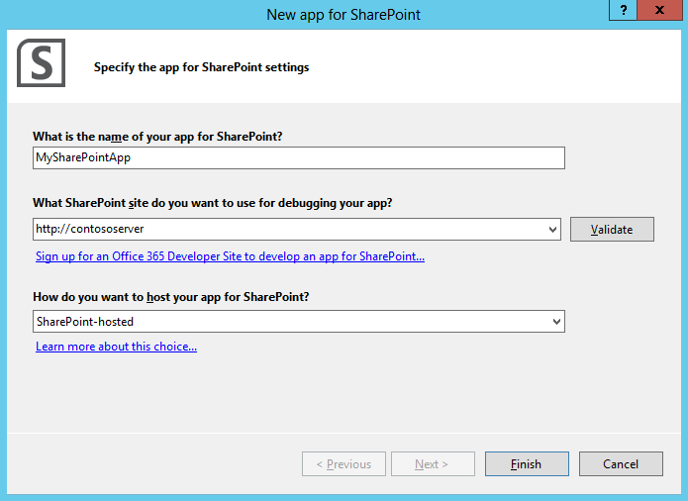
Creating a SharePoint App
There is one project template for SharePoint App
Creates a SharePoint project deployed via new App Model
Notes:
Creating a new SharePoint app project is easy. You simply create a new Visual Studio project using the SharePoint 2013 App template that is available with Visual Studio 2012. When you create a new project, Visual Studio prompts you for the URL to a test site that will be the target site for app installation when it is time to deploy, test and debug your app.

Slide 20
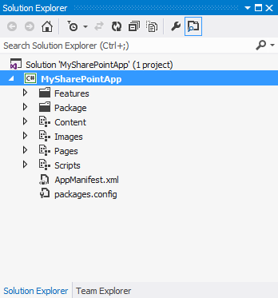
SharePoint-hosted App Project Anatomy
App Web Feature
Used to add items to App Web
Modules
Content module
Images module
Pages module
Scripts module
AppManifest.xml
Contains metadata for app deployment
Notes:
Each SharePoint app project created as a SharePoint-hosted app contains a single feature which is used to add elements to app web such as lists, pages and JavaScript files. Note that each SharePoint app project should contain exactly one feature and the scope of this feature should be equal to web which means the features activates at the site within the app web.
A new SharePoint app project is created with the following modules:
Content module: Used to add CSS files and images to app web
Images module: Used to add image for App icon
Pages module: used to add pages (.aspx and .htm) to app web
Scripts module: used to add JavaScript source files to app web
Everything SharePoint app required a manifest files which is named AppManifest.xml. The Visual Studio project template for SharePoint application automatically adds this file and provides default values for all the required settings.

Slide 21
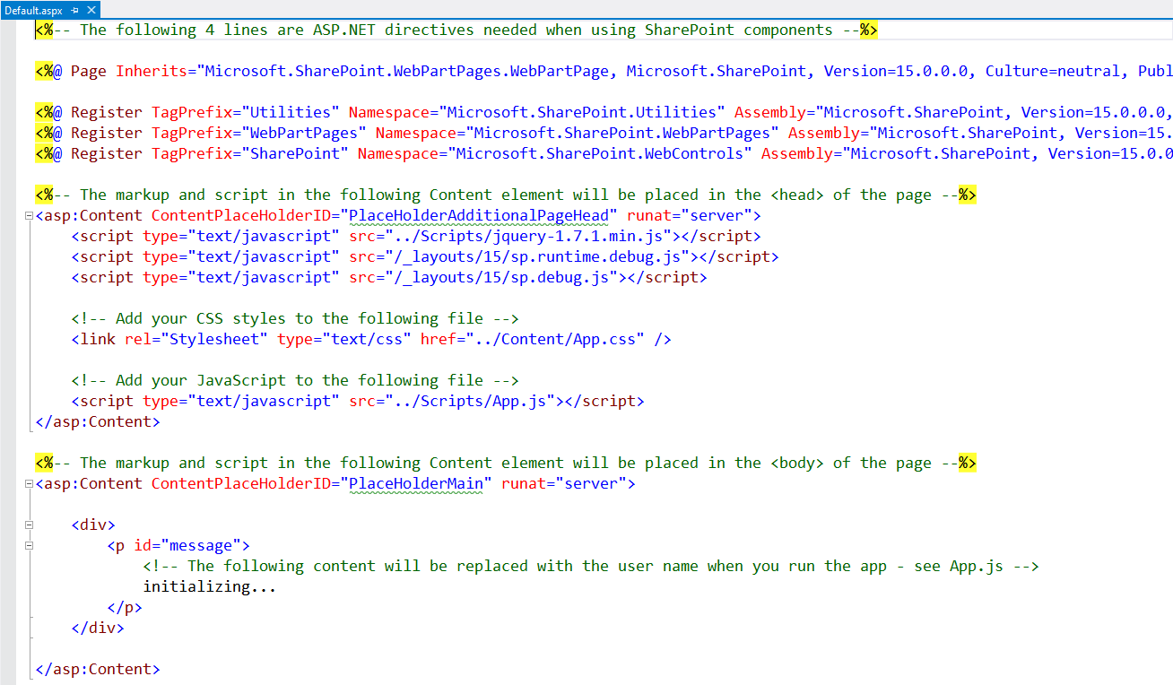
Modifying Default.aspx
Visual Studio automatically adds links to App.css and App.js
Notes:
When Visual Studio creates a new Visual Studio project for a SharePoint app, it automatically adds a start page named Default.aspx. Inside Default.aspx it adds two Content controls for the placeholders PlaceHolderAdditionalPageHead and PlaceHolderMain.
Inside PlaceHolderAdditionalPageHead , Visual studio automatically adds links to App.css and App.js. PlaceHolderMain contains some sample markup for your app. There is where you add the HTML to create the user interface for your start page.

Slide 22
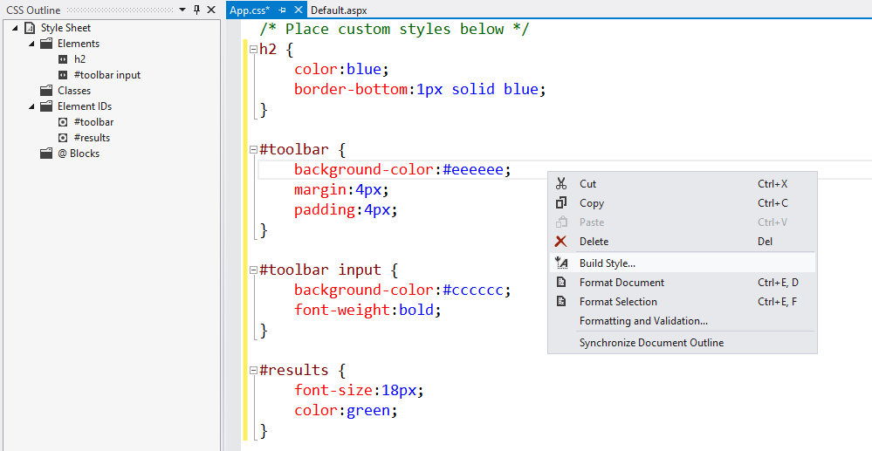
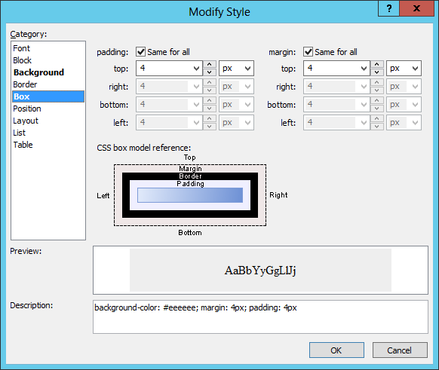
Modifying App.css
Notes:
While Visual Studio create the App.css file for you, this file is initially empty. This is where you add the CSS to style the HTML elements to Home.aspx as well as any other HTML page you might add to your project.
Note that while you can directly edit CSS rules by hand inside App.css, there is also a visual editor that can be invoked by right-clicking the CSS file and select the Build Style… content menu command. This can provide an effective utility for those developers who are working with CSS for the first time and are not yet familiar with the syntax of CSS.

Slide 23
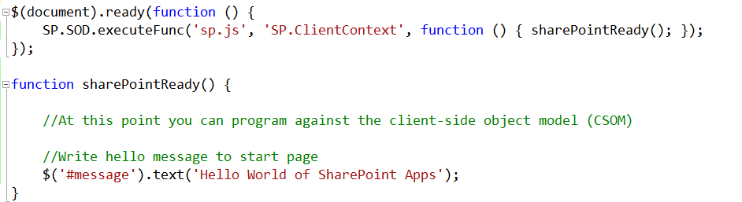
Modifying App.js
Notes:
Here is a simple example of writing the “hello world” JavaScript behind Default.aspx. This code uses the jQuery document ready handler to call SP.SOD.executeFunc to register a callback function named sharePointReady which will fire when the page has loaded the script file named sp.js which is need to use the client-side object model.
The code within the sharePointReady function updates the user interface of Default.aspx by updating the content of the div element with the id of message.

Slide 24
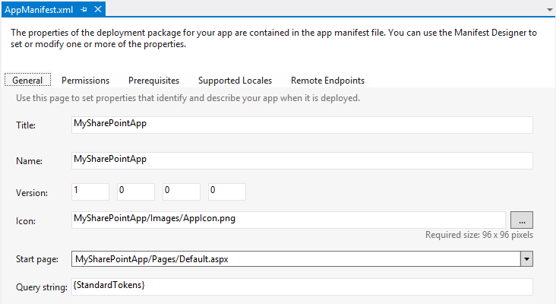
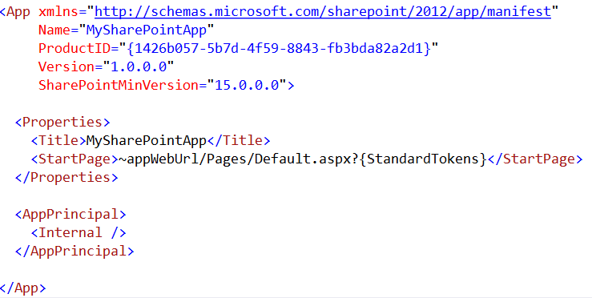
The AppManifest.xml File
AppManifest.xml defines high-level app attributes
Visual Studio 2012 provides visual designer
You can open AppManifest.xml in code view to see/edit XML directly
Notes:
The application manifest file named AppManifest.xml is very important because it contains the application’s high-level metadata that is read by SharePoint during app installation. The version of AppManifest.xml shown in this example is very simples and represents the initial settings of the app after you create a new project.
Note that a SharePoint application has a Name property which is used to construct the Url to the app’s start page. It also has an identifying GUID which served as the ProductID. There is also a Version number and an SharePointMinVersion attribute with a value of 15.0.0.0 that indicates the SharePoint application required SharePoint 2013 or later.
The AppManifest must specify an application principal using an AppPrincipal element. The Internal setting is supplied by Visual Studio by default and can be used for SharePoint-hosted apps.

Slide 25
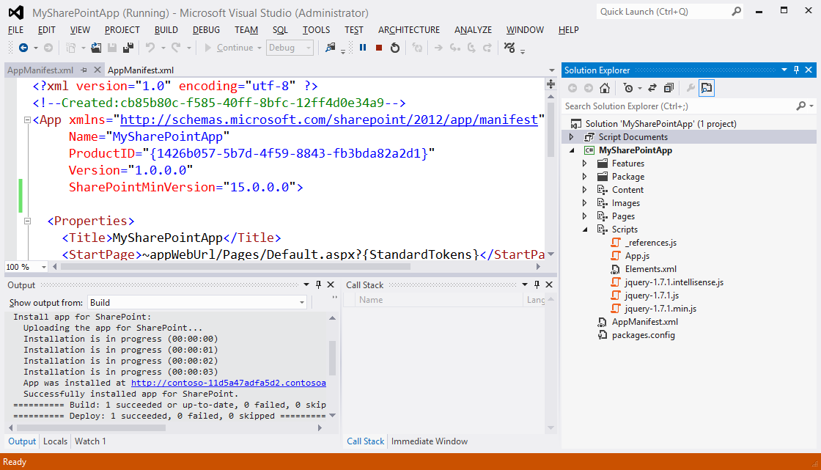
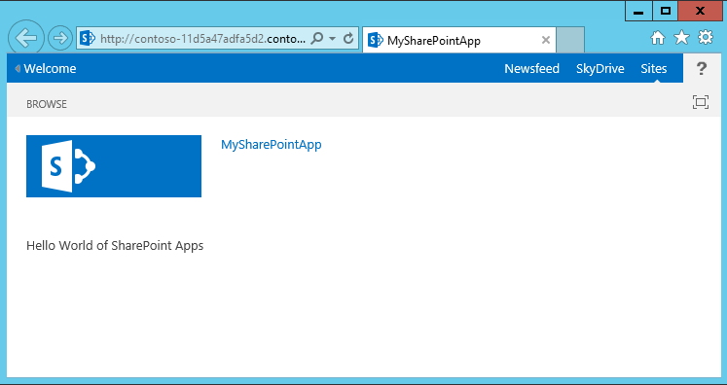
Test an App using {F5}
Notes:
So how do you test and debug a SharePoint app project? It’s just like every other type of project in Visual Studio. You press the {F5} key to begin the process of packaging and deploying the app for testing.
Note that is might take a long time such as 20 or 30 seconds to deploy your app the first time you press the {F5} key. However, it is much faster after that. When you press the {F5} for the second or third time, it often deploys in about 5-10 seconds.

Slide 26
Creating and Testing a New SharePoint App
demo

Slide 27
Packaging and Deployment

Slide 28
Application Packages
SharePoint App deployed using Application packages
Application package is ZIP archive containing files to be deployed
ZIP file created with Open Package Convention format same file format used by Microsoft Word (.docx) and Microsoft Excel (.xslx)
Application package must contain AppManifest.xml file
Application package contains other files as needed
Application packages have .app file extension
MySharePointApp.app
Appmanifest.xml
…
Application Package often contains other files as well
Notes:
A SharePoint app is packaged up for deployment using a ZIP archive file known as an Application package. Note that the ZIP file for an Application package is created using the same Open Package Convention format that is used for Word documents (docx) and Excel workbooks (xslx).
It is a requirement for the application package to contain a AppManifest.xml file. This is what SharePoint uses to read the apps metadata during installation. The application package can and usually contains other files as needed for the app’s implementation.
Note that the ZIP file for an Application packages must have an file extension of .app. In earlier betas, application packages were given a file extension of .spapp instead of .app.

Slide 29
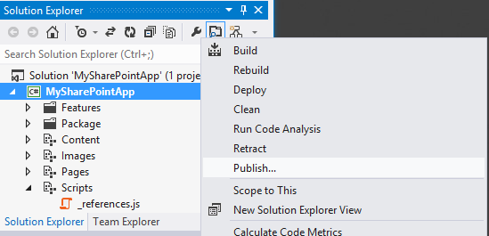
The Publish Command
Publishing Wizard used to generate Application Package
Must be published to folder in file system
Notes:
When it is time to build an application package for distribution you can use the Publish command which is an available menu command when you right-click a SharePoint application project in the Solution Explorer. This command allows you to select a location such as the local hard drive to write the new file.

Slide 30
Application and Inner Solution Packages
Application package contains inner solution package (.wsp)
Inner solution package required to deploy site elements to App Web
Inner solution package contains Web-scoped feature for App Web
Inner solution package contains declarative elements only (e.g. Lists, Pages, etc.)
Inner solution package cannot contain DLL or any .NET code
MySharePointApp.app
Appmanifest.xml
MySharePointApp.wsp
manifest.xml
feature.xml
elements.xml
Home.aspx
App.css
App.js
Notes:
It’s important for developers to understand the contents of an application package file. The most important file that is included is the application manifest file named AppManifest.xml. The application package in most cases will also contain an inner solution package. The inner solution package is a CAB file with a .wsp file extension which has the exact same file format as the solution packages you distribute for farm solutions and sandboxed solutions.
The inner solution package is required to deploy site elements to the app web. The inner solution package contains exactly one Web-scoped feature which is what adds declarative elements to the app web when an app is installed. Remember that the inner solution package can contain declarative elements such as lists, pages, CSS files and JavaScript files. However, the inner solution package cannot contain a DLL or any .NET code whatsoever. Therefore, you can say that the inner solution package is constrained to be a fully declarative solution package. This is different than the solution packages for farm solutions and sandboxed solutions which can contains DLL assemblies with code written in either C# or VB.NET.

Slide 31
App Web and Host Web Features
MySharePointApp.app
Appmanifest.xml
Customaction1.xml
ClientWebPart.xml
Host Web
App Custom Actions
Client Web Parts
MySharePointApp.wsp
manifest.xml
feature.xml
App Web
Lists
Site Pages
CSS Files
JavaScript Files
elements.xml
Home.aspx
App.css
App.js
Notes:
Note that an application can contain the following two types of elements can be added to the host web as opposed to all other types of elements that are added to the app web:
Client Web Apps
App Custom Actions
Client Web Parts allow you to add view ports into the host web via an iFrame which display a page from either the app web or from a cloud-based application associated with the app. Client Web Parts are discovered and added to pages in the host web in a fashion which is very similar to adding standard Web Part.
App custom actions allow your app to add custom controls to the ribbon and custom menu items to various menus such as the file item menu (aka ECB menu) within a list. Note that the custom actions available to apps are only a subset of the custom actions avaibale when creating a sandboxed solution or a farm solution.
There will be a more complete discussion of using client web parts and app custom actions in an upcoming lecture.

Slide 32
Testing an App with CTRL + {F5}
Here is what happens when you press CTRL + {F5}
It fixes URL’s in AppManifest.xml and other project files
It creates the inner .wsp file for the App Web
It creates the Application package and adds file inside
The App.manifest file
The inner .wsp file
Other files associated with Host Web feature (if any)
It installs the Application package using the lifecycle API
It updates “hosts” file with App DNS setting on local machine
It launches IE and navigates to home page of App Web
Notes:
The following is a detailed walkthrough of what happens when you press the CTRL + {F5} keyboard combination.
First, Visual Studio replaces various tokens such as the ~remoteAppUrl token with the actual URL in AppManifest.xml and other project files. Take care to note that the ~appWebUrl token is not replaced by Visual Studio but instead by SharePoint during app installation.
Next, Visual studio creates the application package and it adds the AppManifest.xml file, the inner .wsp file and any other files associated with host web feature (if any).
Next, Visual Studio installs the Application package using the SharePoint app lifecycle API.
Next, Visual Studio updates “hosts” file (aka the LMHOST file) with a DNS setting on local machine so that the newly established domain name for the app is directed back to local machine using an IP address of 127.0.0.1.
Finally, Visual Studio launches the Internet Explorer and navigates to a specific page which allows you to begin your testing. It is important to note that the location of the app’s start page affects which page Visual Studio directs you to. Visual Studio will direct you directly to a start page if it exists within the app web as was the case in the demo you just saw. However, if the start page is configured to point to an external page in a cloud-host app, then Visual Studio directs you to a page in the host web with a launcher that you can click to direct you to the start page.

Slide 33
Testing an App with {F5}
Here is what happens when you press CTRL + {F5}
It fixes URL’s in AppManifest.xml and other project files
It creates the inner .wsp file for the App Web
It creates the Application package and adds file inside
The App.manifest file
The inner .wsp file
Other files associated with Host Web feature (if any)
It installs the Application package using the lifecycle API
It updates “hosts” file with App DNS setting on local machine
It launches IE and navigates to home page of App Web
It attaches the Visual Studio JavaScript debugger to IE
Notes:
The only difference between start an app with the CTRL + {F5} keyboard and combination and starting an app by pressing the {F5} key has to do with whether or not you want Visual Studio to attach its JavaScript debugger to the Internet Explorer during your test/debug session. When you press the {F5} key without the CTRL key, Visual Studio attaches its JavaScript debugger which allows you to single step through your JavaScript code inside Visual Studio.
Note that you can only attach one JavaScript debugger at a time. Therefore, if you would like to single-step through your JavaScript code using the Internet Explorer Developer Tools, you should start the project using CTRL {F5} instead of {F5}.

Slide 34
Inspecting the App Package for a SharePoint App
demo

Slide 35
Summary
SharePoint 2013 Development
SharePoint Application Design Patterns
Creating a SharePoint App Project
Packaging and Deployment

Slide 36
Q&A

Slide 37

© 2012 Microsoft Corporation. All rights reserved. Microsoft, Windows, Windows Vista and other product names are or may be registered trademarks and/or trademarks in the U.S. and/or other countries.
The information herein is for informational purposes only and represents the current view of Microsoft Corporation as of the date of this presentation. Because Microsoft must respond to changing market conditions, it should not be interpreted to be a commitment on the part of Microsoft, and Microsoft cannot guarantee the accuracy of any information provided after the date of this presentation. MICROSOFT MAKES NO WARRANTIES, EXPRESS, IMPLIED OR STATUTORY, AS TO THE INFORMATION IN THIS PRESENTATION.

